Slide 1
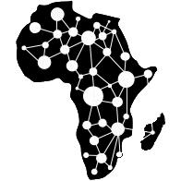

Environmental Data Acquisition and Processing
Water Resource Monitoring and Catchment Analysis
By
Jason Kabi
Centre for Data and Artificial Intelligence
DSAIL

Slide 2
Session breakdown
Session BrakeDown
Motivation – The main goal
What water parameters are being monitored?
How are the parameters monitored?
Hardware development
Data acquisition
Data analysis – Anomaly detection
1

Slide 3
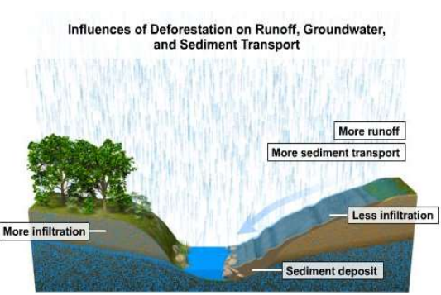
Motivation
Main goal: River catchment analysis using water-level data by leveraging IoT and machine learning
Takeaways
Water level data can be used to “diagnose” a river catchment by watching the trends over some time.
Question: How long does a spike in water level take to occur after a spike in rain.
2

Slide 4
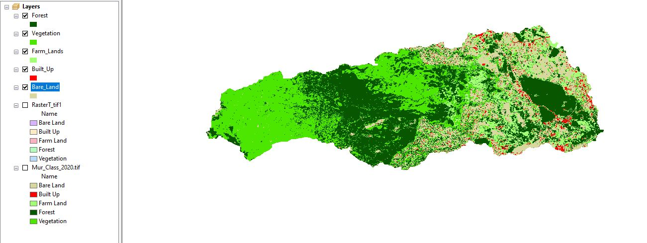
Catchment under study
Muringato Water shed – Nyeri - Kenya
3

Slide 5
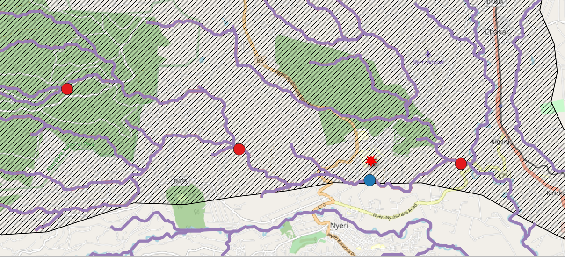
Deployment location (catchment under study)
4

Slide 6
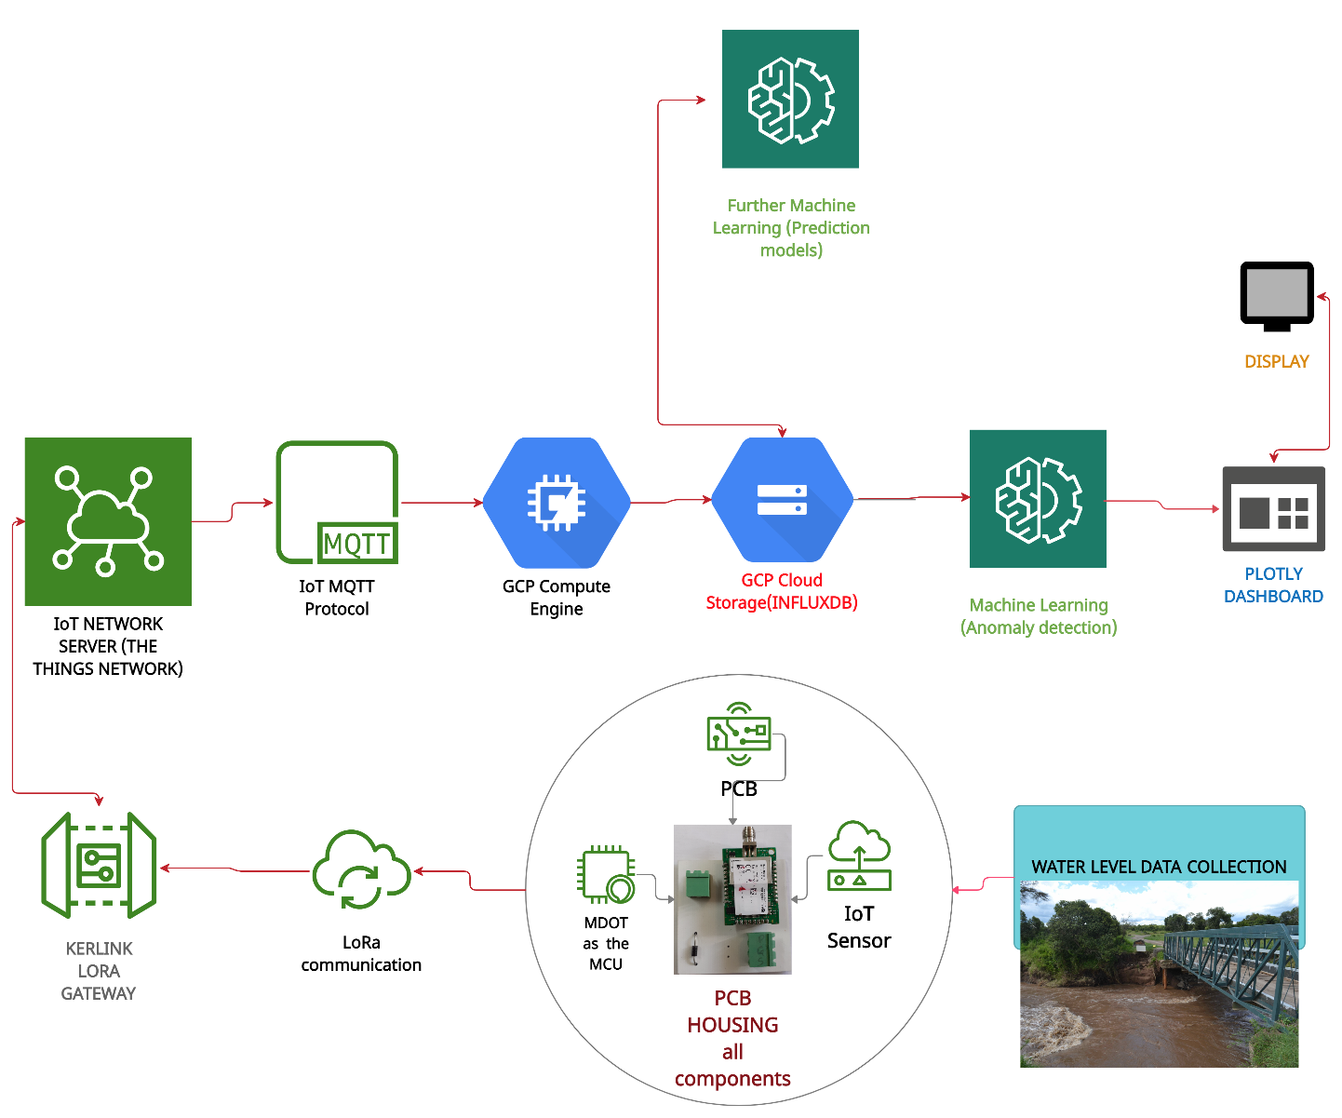
Water level monitoring setup (Flow Chart)
5

Slide 7
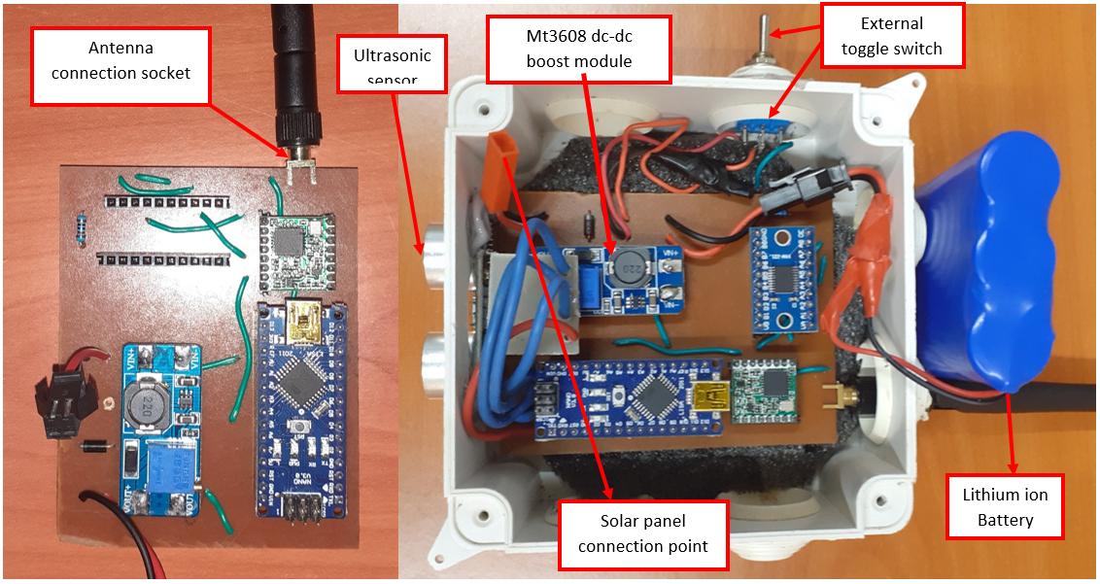
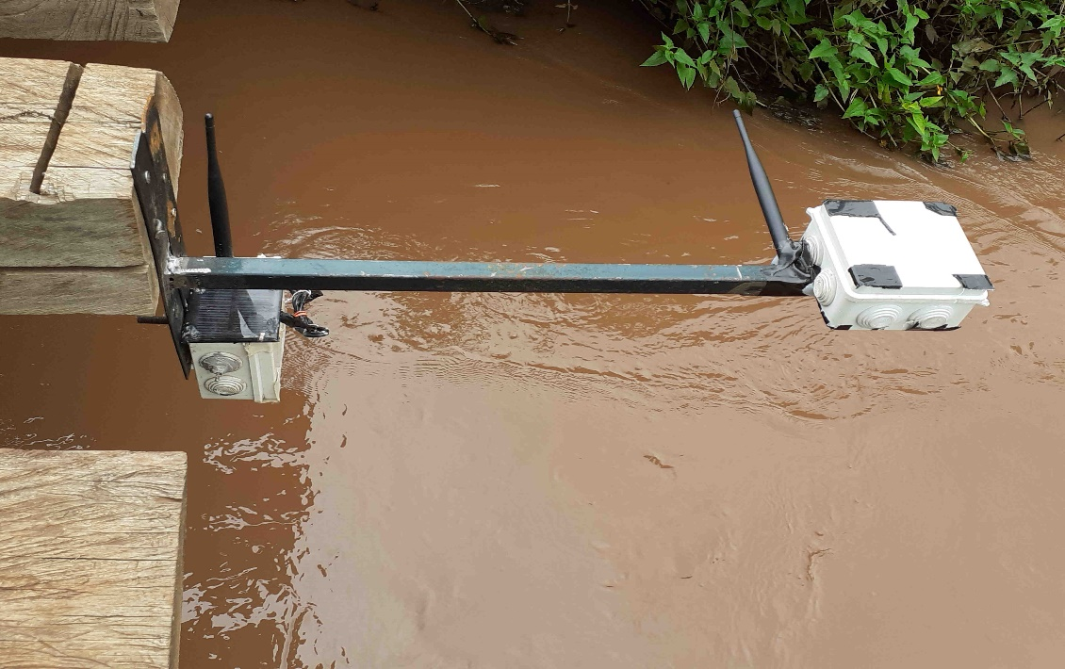
Hardware setup
Ready for deployment
Deployed
6

Slide 8
UPNEXT
ANOMALY DETECTION ON TIME SERIES WATER LEVEL DATA
7

Slide 9
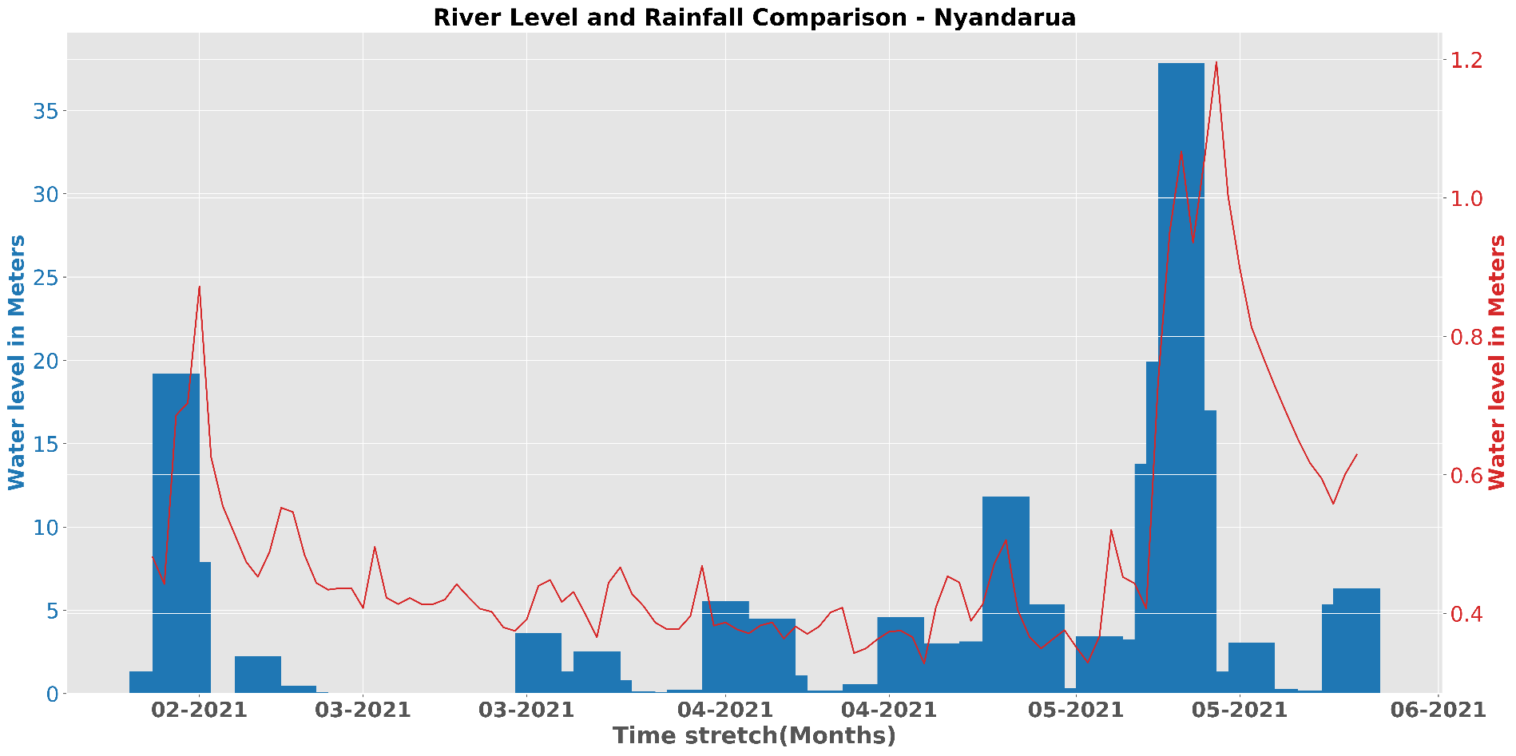
Integration with other data sets (rainfall data from TAHMO)

Slide 10
THANK YOU
Web - Dekut-dsail.github.io
Web - kabi23.github.io
Github – DEKUT-DSAIL

